Slide 1

ANDROID APPLICATION DEVELOPMENT

Slide 2

WHAT IS ANDROID?
Android is a software package and Linux based operating system for mobile devices such as tablet computers and smartphones.
Android is a mobile operating system developed by Google, based on a modified version of the Linux kernel and other open source software and designed primarily for touchscreen mobile devices such as smartphones and tablets.
Android was developed by Google and the Open Handset Alliance (OHA), a coalition of hardware, software and telecommunications companies. More than 30 companies were involved in the OHA, including Qualcomm, Broadcom, HTC, Intel, Samsung, Motorola, Sprint, Texas Instruments and Japanese wireless carriers KDDI and NTT DoCoMo.

Slide 3
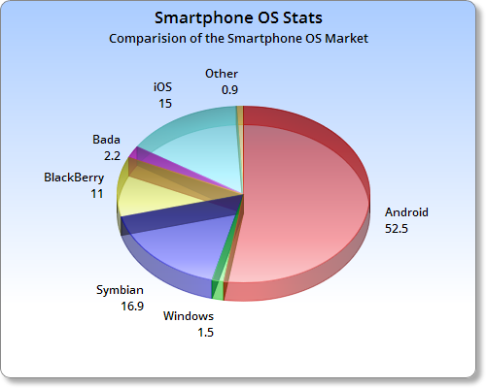
WHY ANDROID IS SO POPULAR?
Open Source
Anyone can customize the Android Platform.
Application Store (Google play store)
There are a lot of mobile applications
that can be chosen by the consumer.
Android targets Common Man
It provides support for messaging services(SMS and MMS), web browser, storage (SQLite), connectivity (GSM, CDMA, Blue Tooth, Wi-Fi etc.), media, handset layout etc.
Market Share

Slide 4
HISTORY OF ANDROID
Initially, Andy Rubin founded Android Incorporation in Palo Alto, California, United States in October, 2003.
In 17th August 2005, Google acquired android Incorporation. Since then, it is in the subsidiary of Google Incorporation.
The key employees of Android Incorporation are Andy Rubin, Rich Miner, Chris White and Nick Sears.
Originally intended for camera but shifted to smart phones later because of low market for camera only.
Android is the nick name of Andy Rubin given by coworkers because of his love to robots.
In 2007, Google announces the development of android OS.
In 2008, HTC launched the first android mobile.

Slide 5
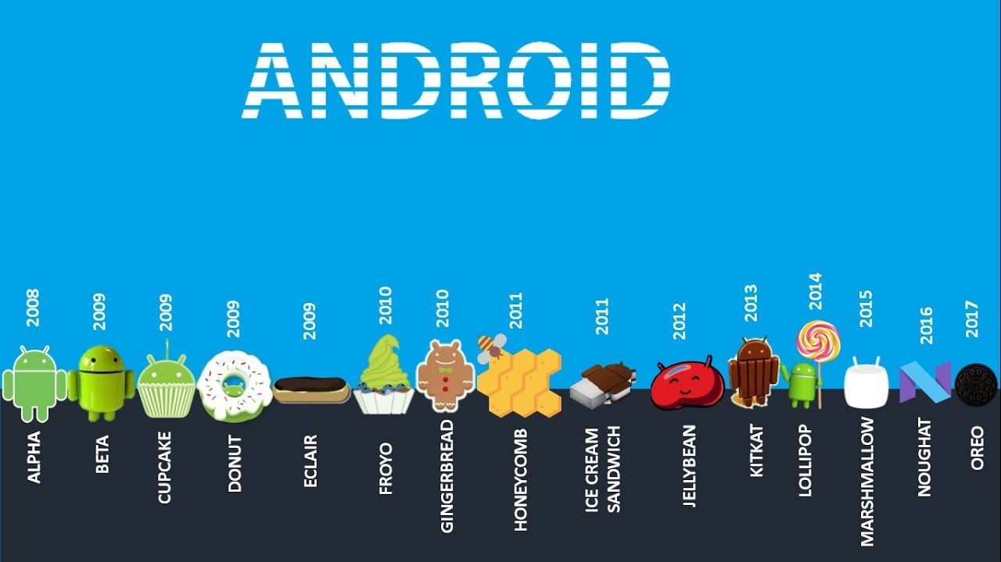
Android version is the number of updates to the base OS

Slide 6
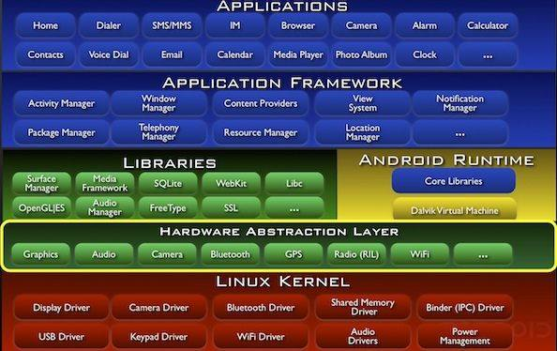
ARCHITECTURE OF ANDROID

Slide 7
SETTINGUP DEVELOPMENT ENVIRONMENT
A development machine running Linux, macOS, or Windows.
JDK 1.8 or later. (You can download the latest version of Java JDK from Oracle's Java site.)
Android Studio 3.0 or higher. https://developer.android.com/studio/index.html
You can find the SDK path going into Android Studio
Tools -> SDKManager -> On the top left it should say SDK Path.
Go to SDKManager-> Download the necessary platforms and tools.
Create AVD (Android Virtual Device) -> Open the AVD Manager by clicking Tools > AVD Manager.
Follow the steps from https://developer.android.com/studio/run/managing-avds.html#createavd

Slide 8
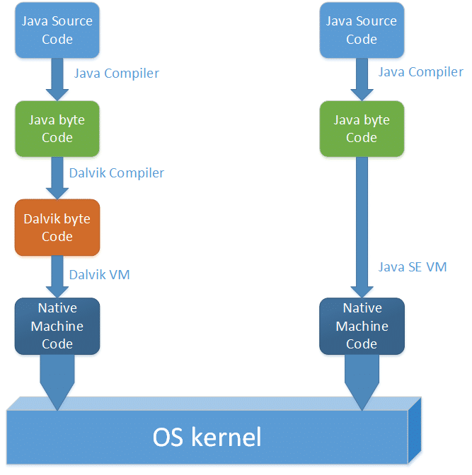
DVM (Dalvik Virtual Machine)
The Dalvik Virtual Machine (DVM) is an android virtual machine optimized for mobile devices. It optimizes the virtual machine for memory, battery life and performance.

Slide 9
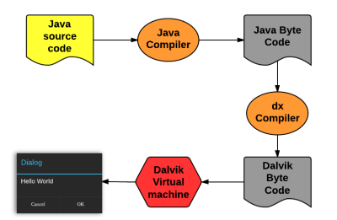

Slide 10
API LEVELS
API Level is an integer value that uniquely identifies the framework API revision offered by a version of the Android platform.
Code name | Version number | Initial release date | API level | Security patches
Oreo | 8.0 – 8.1 | August 21, 2017 | 26 – 27 | Supported
Nougat | 7.0 – 7.1.2 | August 22, 2016 | 24 – 25 | Supported
Marshmallow | 6.0 – 6.0.1 | October 5, 2015 | 23 | Supported
Lollipop | 5.0 – 5.1.1 | November 12, 2014 | 21 – 22 | Unsupported
KitKat | 4.4 – 4.4.4 | October 31, 2013 | 19 – 20 | Unsupported
Jelly Bean | 4.1 – 4.3.1 | July 9, 2012 | 16 – 18 | Unsupported
Ice Cream Sandwich^{[9]} | 4.0 – 4.0.4 | October 18, 2011 | 14 – 15 | Unsupported
Honeycomb^{[8]} | 3.0 – 3.2.6 | February 22, 2011 | 11 – 13 | Unsupported

Slide 11
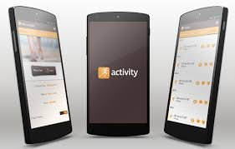
ACTIVITIES

Slide 12
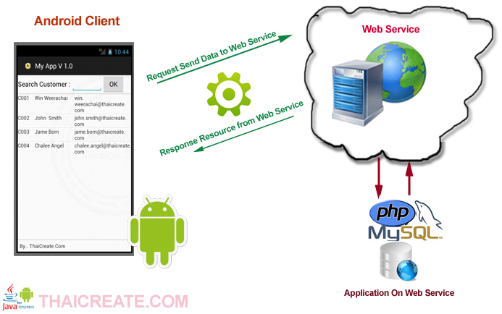
SERVICES

